Slide 1
Java Server Pages (JSP)
Lesson 05: Writing Java Server
Page
Notes:
Add instructor notes here.

Slide 2
Lesson Objectives
In this lesson, you will learn:
Developing a Simple Java Server Page
Notes:
This lesson is to give an overview on how to develop Java Server Pages

Slide 3
1.1: Developing a Simple Java Server Page Minimum Steps for developing JSP
Following steps have to be followed for developing JSP:
Write the JSP file.
Deploy the JSP file and any associated files in the web server.
Invoke the JSP file from the browser.
Notes:
Developing Java Server Page:
Minimum steps needed to develop a Java Server Page:
Following steps have to be followed for developing JSP:
Write the JSP File
Declare any JavaBeans components.
Use tag-centric syntax to access Bean properties or scripting-centric syntax to provide desired functionality.
Save the file with a .jsp filename extension.
Deploy the JSP file and any associated files in the web server (Please refer to the JSP lab book for more details).
Place the .jsp files under the context root directory.
Place associated .class files in WEB-INF\classes folder and .jar files in web-inf\ lib folder.
Invoke the JSP file from a web browser.
Type the URL in the browser as follows: http://<host-name>/<context-root>/<path>/<jsp file name>
Explain in brief the minimum steps required to develop & execute a JSP page. All these steps will need to be demonstrated as part of the demo at the end of the lesson.

Slide 4
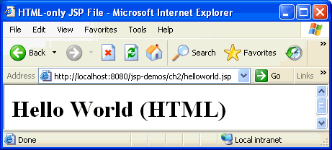
1.1: Developing a Simple Java Server Page JSP Example (Only HTML)
<html> <head>
<title> HTML – only JSP File </title>
</head>
<body> <h1> Hello World (HTML)</h1>
</body>
</html>
Notes:
Developing Java Server Page:
The above slide shows an example of a JSP file that contains only HTML.
A file containing nothing but standard HTML code can be renamed with a filename extension of .jsp and therefore meet the minimum requirements to be invoked as a Java Server Page. Such a file would still be parsed and compiled to a servlet. The servlet would still return a response when the page was invoked - its response to the client would simply contain the original HTML.
Explain that when a html file is saved as .jsp then it will be processed as a JSP file by the server and not as a static html page.
JSP 2.1 version requires following jars:
1) ant-1.6.5.jar
2) core-3.1.1.jar
3 jsp-2.1.jar
4) jsp-api-2.1.jar

Slide 5
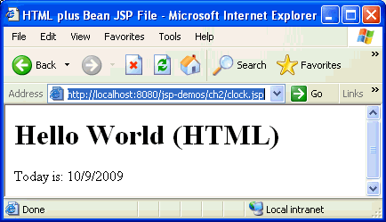
1.1: Developing a Simple Java Server Page JSP Example (HTML+component-centric tags)
<html>
<head> <title>HTML plus Bean JSP File</title> </head>
<jsp:useBean id="clock" scope="page“ class=“beans.JspCalendar" type=“beans.JspCalendar" />
<body>
<h1>Hello World (HTML)</h1>
<p>Today is: <jsp:getProperty name="clock“ property="date"/></p>
</body>
</html>
Notes:
Developing Java Server Page:
JSP Example (HTML + component-centric tags):
The above slide shows an example of a JSP file that contains HTML and component-centric tags.
Of course, the whole point of Java Server Pages technology is to simply and easily manage dynamic content on the server side. So, the plain HTML file from above, we can add some Java Server Pages tags to interact with Java components. Component can be as simple as a Bean, which returns the current time.
Explain the meaning of component centric tag in brief and point out the same in the code on the slide.

Slide 6
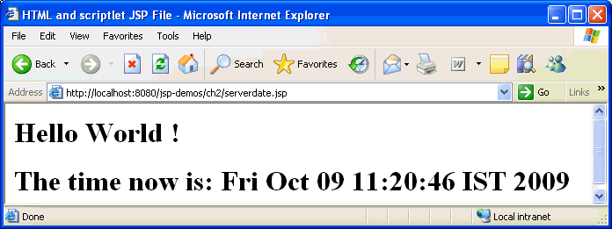
1.1: Developing a Simple Java Server Page JSP Example (HTML + script-centric tags)
<html>
<head>
<title>HTML and scriptlet JSP File</title>
</head>
<body>
<h1>Hello World !
<p> <% out.println (“The time now is : “ + new java.util.Date() ); %>
</h1>
</body>
</html>
Notes:
Developing Java Server Page:
JSP Example (HTML + script-centric tags)
The above slide shows an example of a JSP file that contains HTML and script-centric tags.
Although Java Server Pages architecture encourages the use of componentization for ease of maintenance and reusability, It does not required to use components. This example uses a simple scriptlet containing raw Java code.
Explain the meaning of script-centric tag in brief and point it out in the code on the slide. Explain the output as well.

Slide 7
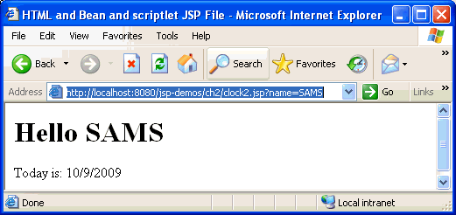
1.1: Developing a Simple Java Server Page JSP Example (ALL tags)
<html>
<head> <title> HTML and Bean and scriptlet JSP File </title></head>
<jsp:useBean id="clock" scope="page" class="beans.JspCalendar" />
<body>
<h1> <% if (request.getParameter ("name") == null) {
out.println ("Hello World");} else { out.println ("Hello " + request.getParameter("name")); } %> </h1>
<p>Today is: <jsp:getProperty name="clock" property="date"/> </p>
</body>
</html>
Notes:
Developing Java Server Page:
JSP Example (All tags):
The above slide shows an example of a JSP file that contains HTML, component centric and script-centric tags. This is the same example where we had only HTML tags with the substitution of two lines of code for the original Hello line. By checking for a name parameter in the incoming request (available in the automatic request object), the page can return either a generic or a personalized greeting.
Remember to save the file with a .jsp filename extension. This tells the web server that the file is a Java Server Pages file and to process it accordingly.
This example has all possible combinations. Explain the code & output in brief.

Slide 8
Demo: Developing and Executing Simple JSPs
Demo on:
onlyHtml.jsp
onlyJsp.jsp
jspWithHtml.jsp
serverdate.jsp
javaCode1.jsp
javaCode2.jsp
Notes:
Deploy web application Lesson1-JSPIntroduction and show demo by executing each of the above JSP pages.
Demonstrate all the combinations (i.e. only html, html + component-centric tags etc.) that are possible in a JSP page

Slide 9
Summary
In this lesson, you have learnt:
Developing a Java Server Page

Slide 10
Review – Questions
Question 1: A JSP page can consist of HTML,___, and ___ centric tags.
Question 2: JSP pages should be placed under ___ directory of the web application.
Notes:
Answers for the Review Questions:
Answer 1: component; script
Answer 2: context-root

